Slide 1
Project Tittle, Hand gesture recognition for Human-Computer Interaction

Slide 2
Introduction, What is Hand gesture recognition using computer vision?
Gestures are a natural and intuitive form of both interaction and communication.
When we take this idea towards human-computer interaction, we recognise human hand gestures through a camera and assign actions to them.
Thus, we get Hand gesture recognition using computer vision.

Slide 3
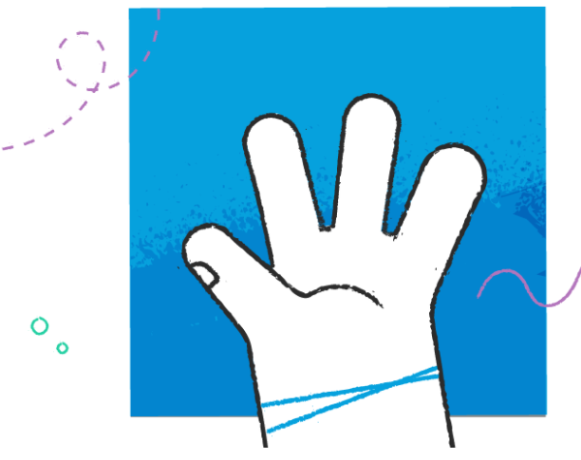
AI Virtual Mouse and a
Gesture based Volume Controller
We aim to reduce any and all unnecessary contact while operating a system,
We use a custom version of a hand recognition module in computer vision to recognize predefined gestures and assign appropriate actions to them in order to create a virtual computer mouse.
Furthermore, Since we are no longer bound by the limitations of a physical mouse. we wish to redefine the conventions of operating a computer. Starting with developing a virtual gesture-based volume controller.

Slide 4
Motivation,
New and exciting technologies such as artificial intelligence, computer vision, etc. and deeply motivated to be able to bring our ideas to life with working prototypes.
Contribute to solving current problems of our time such as finding technological ways to battle a pandemic and inspire others to do the same.
Learn more by researching the potential and overall scope of these new age concepts. We feel the best way to start is to implement our ideas.

Slide 5
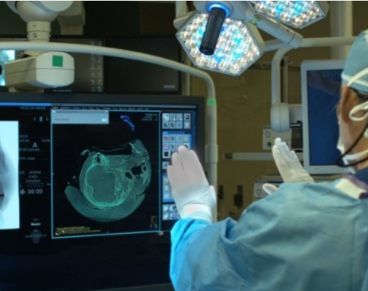
Problem Statements,
(What unmet need is addressed by technology)
Covid-19 Era, There is a need for "no Contact" Common equipment used by essential workers,
Currently, we have social distancing methods, constant use of disinfectants to reduce rates of spreading
However, With gesture based 'Little to no contact' systems in place, we reduce points of contact. Thus, Creating a safer environment.
Healthcare,
As of now assistants help out with managing systems and this causes crowding in an enclosed place and is counterintuitive
Gesture recognition can help to keep surgical wards sterile. By reviewing medical documentation or controlling the camera without touching the screen, the surgeon can reduce the risk of infection.
Inexpensive accessibility options

Slide 6
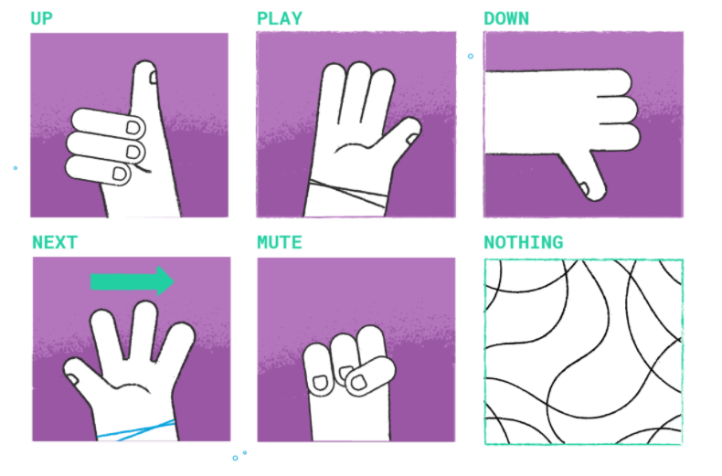
Consumer Electronics,
Smartphones or TVs with embedded cameras allow us to use our hands to interact with media applications
Automotive,
Hand gestures are mostly used for infotainment systems to control in-car music players and phone systems.
Gestures can also be used for lights control and GPS navigation.
Improved convenience and user experience, as the driver no longer has to touch around the dashboard trying to find a button to switch radio stations or answer a phone call through the loudspeaker system.
Entertainment,
Virtual Reality is another beneficiary of gesture recognition.
Most game consoles require controllers, but Kinect proved that it is not required. Using full-body movements can make your whole body a game controller

Slide 7
Innovation,
Standard Hand recognition technology uses expensive hardware, Hence, is difficult to implement in a large scale.
However, With the advent of computer vision,
Our project needs only a hand, a camera and a basic computer to function as an AI virtual Mouse.
With the right software, we feel it is extremely cost effective to widely implement just by using existing technology, Unlike the 'Kinect' developed by Microsoft.
Also much faster to implement and to bring into action in dealing with time sensitive issues such as the Covid-19 pandemic.

Slide 8
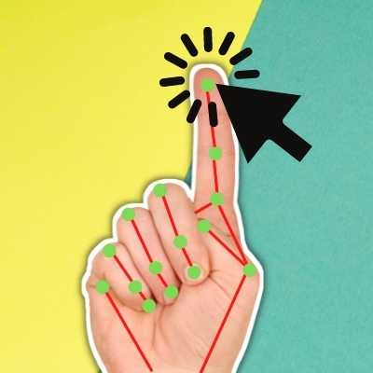
Technology used,
For the Ai Virtual Mouse,
We use the opencv module and mediapipe's open dataset to recognize hands and display the same using opencv's custom methods.
win32api is used for cursor movement and click automation.
PyAutoGUI allows us to use python scripts to control the mouse and keyboard to automate interactions with other applications. The API is designed to be simple.
For the Gesture based volume controller,
We use a handtracking module to calculate the distance between the index and the thumb finger in real time using opencv and mediapipe.
Pycaw helps us access the windows volume slider.
t

Slide 9
Scope,
The future is now:
analog ->touch -> no touch (gesture)
Predictions show that the market for gesture recognition technologies is growing and the sky is the limit
For example, Kinect, developed by Microsoft was originally intended as a system that can track whole-body movements
KinTrans Hands Can Talk, is a project which uses AI to learn and process the body movements of sign language.stup.

Slide 10
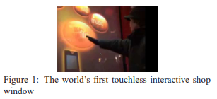
GestSure allows surgeons to navigate through MRI and CT scans without touching a screen.
Audi and BMW have already implemented a system that allows drivers to use gestures to control the infotainment system inside the car
There are also numerous open-source projects for hand gesture recognition, like Real-time-GesRec based on PyTorch.
The Future is immensely bright going forward with Gesture based technology.

Slide 11
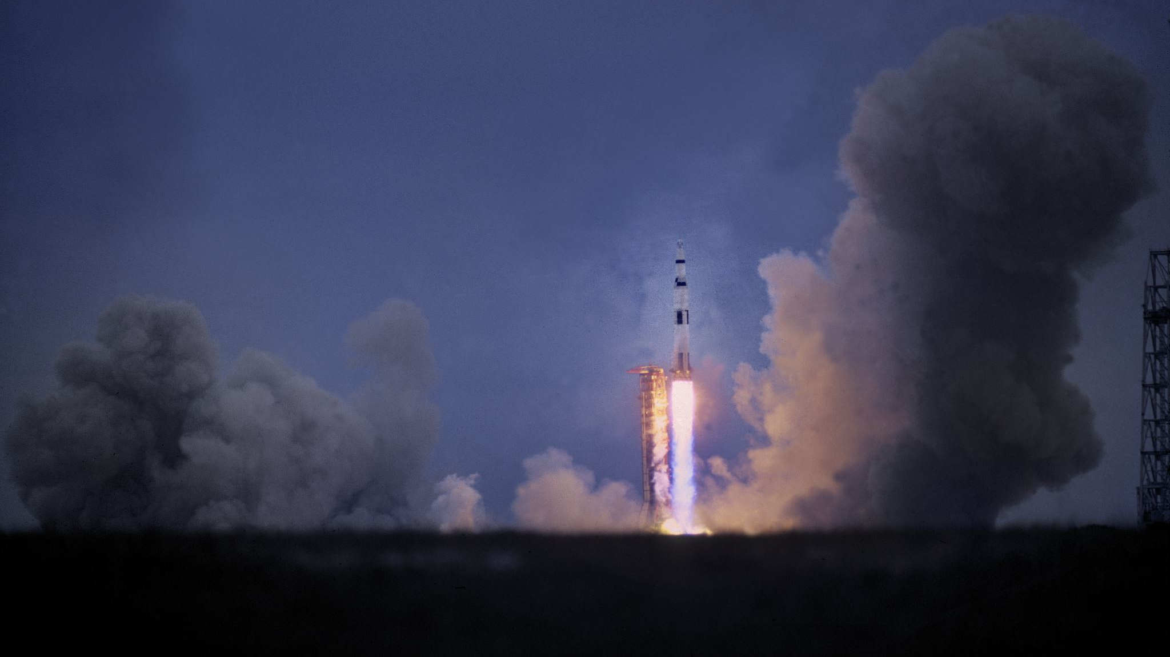
Team
RA1811003010205 - Kavin Chandar
RA1811003010157 - Akshat Prakash Srivastava
Mentor/Guide – Gayathri M

